Slide 1
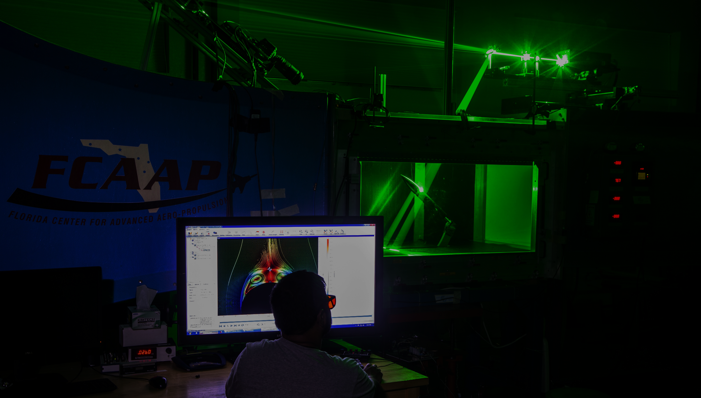
Smart Projectile
Jack Corbin | Prosley Dorcely | Emily Groth
Deepkumar Patel | Aaron Weingarten

Slide 2
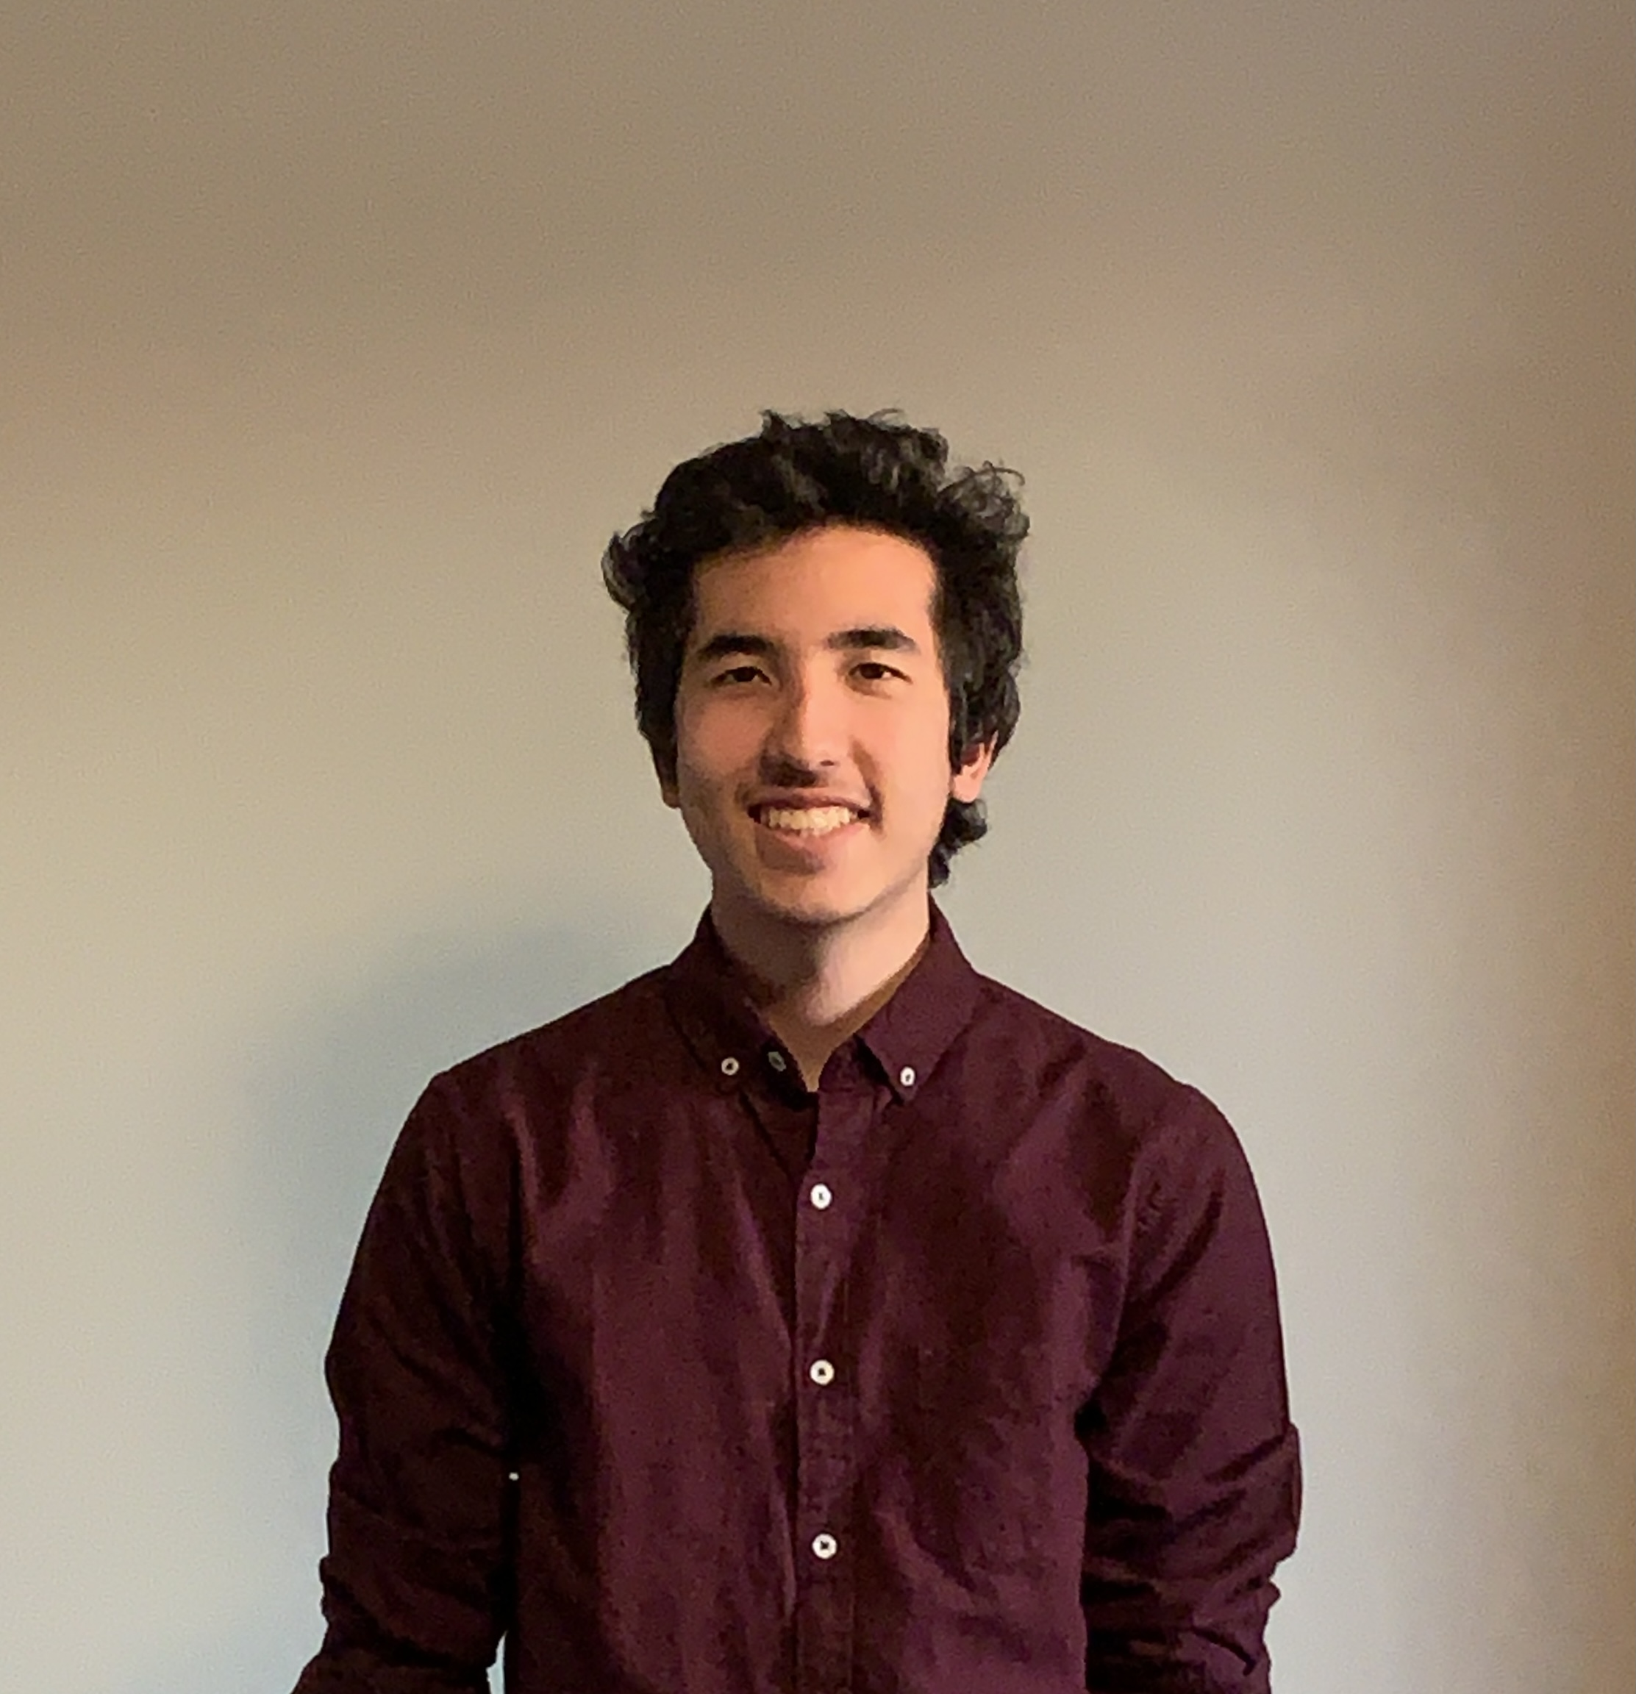
Team 509
Jack Corbin
Test Engineer
Prosley Dorcely
Research Engineer
Emily Groth
Field Engineer
Deepkumar Patel
Design Engineer
Aaron Weingarten
System Engineer
Emily Groth

Slide 3
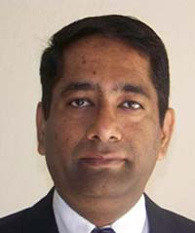
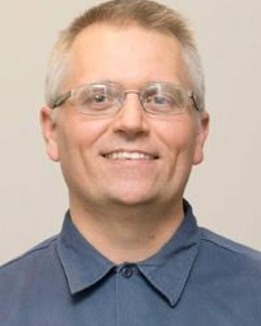
Sponsor and Advisor
Dr. Rajan Kumar
Sponsor
Dr. Jonas Gustavsson
Advisor
Robert Smith
Advisor
Emily Groth

Slide 4
Objective
The objective of the project is to create a scale model of a projectile with an articulating nose cone and deflectable fins for subsonic wind tunnel testing.
Emily Groth

Slide 5
Project Background
The Air force wants to create a missile with increased agility in endgame to improve accuracy
The mechanism by which they will accomplish this is an articulating nose cone
The mechanism by which they will accomplish this is an articulating nose cone
Emily Groth

Slide 6
Project Background
FCAAP is tasked with acquiring data on how nose deflection affects missile flight
2021 - 2022 Team 504 is tasked with creating a wind tunnel model with an articulating nose cone
2022- 2023 Team 509 is tasked with improving and modifying the model created by the previous year’s team
Emily Groth

Slide 7
2021 – 2022 Model
Two angled surfaces used to obtain articulation
Two stepper motors, one for rotation, one for deflection
Emily Groth

Slide 8
Issues with 2021 – 2022 Model
Excess weight caused sagging
Vibration from articulation mechanism​
Fins are not deflectable
Emily Groth

Slide 9
Issues with 2021 – 2022 Model
Excess current lead to overheating and reduced test time​
Non-linear controls​
Emily Groth

Slide 10
Markets and Stakeholders
FCAAP
Air Force
Boeing
Raytheon
Lockheed Martin
General Dynamics
College of Engineering
Dr. Jonas Gustavsson
Dr. Rajan Kumar
Dr. Shayne McConomy
Dr. Suvranu De
Aaron Weingarten

Slide 11
Customer Needs
L/D ration of 8, 12,16
Diameter of 2 inches
Nose deflection between 0 to 5 degrees with resolution ±0.1
Static or dynamic deflectable fins
Time constant optimized to less than 0.5 seconds
Suitable material and design for subsonic testing
Aaron Weingarten

Slide 12
Assumptions
Assumption 1
Assumption 2
Gravitational force will
Assumption 3
No shockwaves will
Model has access to
an outside power
supply and controls.
be far greater than
the aerodynamic
forces.
be produced
(subsonic and
incompressible)
Aaron Weingarten

Slide 13
Functional Decomposition
Nose Actuation
Control
Structure

Slide 14
Functional Decomposition
Nose Actuation
Mechanical
Maintains flow attachment
Roll
Deflection
Smooth transition between nose and body
Aaron Weingarten

Slide 15
Functional Decomposition
Control
Provides linear output for nose deflection
Provides output for fins
Takes user input
Aaron Weingarten

Slide 17
Functional Decomposition
Structure
Maintains Rigidity
Prevents vibrations
Prevents sagging
Attaches to supports
Secures Components
Aaron Weingarten

Slide 18
Future Work
Targets and Metrics
Concept Generation
Concept Selection
Prototyping
Concept Evaluation
Risk Assessment
Bill of Materials
Prototype Modifications
Final Product
Aaron Weingarten

Slide 19
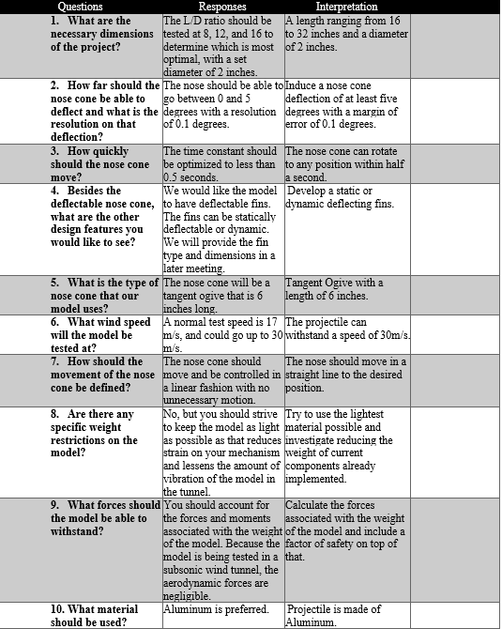
Customer Needs Backup

Slide 20
Markets Backup
Primary Market
FCAAP (Florida Center for Advanced Aero Propulsion)
Secondary Markets
Air Force Office of Scientific Research (AFOSR)
Air Force Research Laboratory (AFRL)
Lockheed Martin
General Dynamics
Raytheon Technologies
Boeing
Northrop Grumman

Slide 21
Stakeholders Backup
Florida Center for Advanced Aero Propulsion
FAMU-FSU College of Engineering
Dr. Rajan Kumar
Dr. Jonas Gustavsson
Dr. Shayne McConomy
Dr. Suvranu De

Slide 22
Standard Shapes
Summary Box
Text box 1
Outlined Text Box

Slide 23
Approved Logos

Slide 24
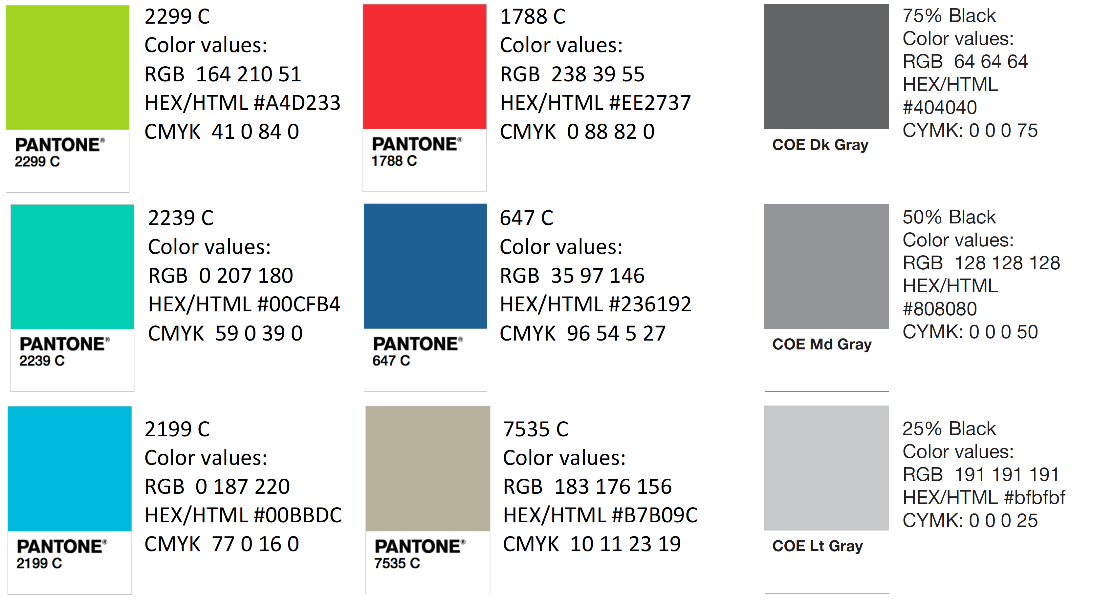
Color Palette

Slide 25
APA Tables
Category 1 | Category 2 | Category 3 | Category 4 | Category 5
Item 1
Item 2
Item 3
Item 4
 | Category 2 |  |  | Category 3
Category 1 | subcategory 1 | subcategory 2 |  | subcategory 1 | subcategory 2
Item 1
Item 2
Item 3
Item 4

